Slide 1

Redemption Realized
What Does the Bible Say?

Slide 2

The Reaction of People…

Slide 3
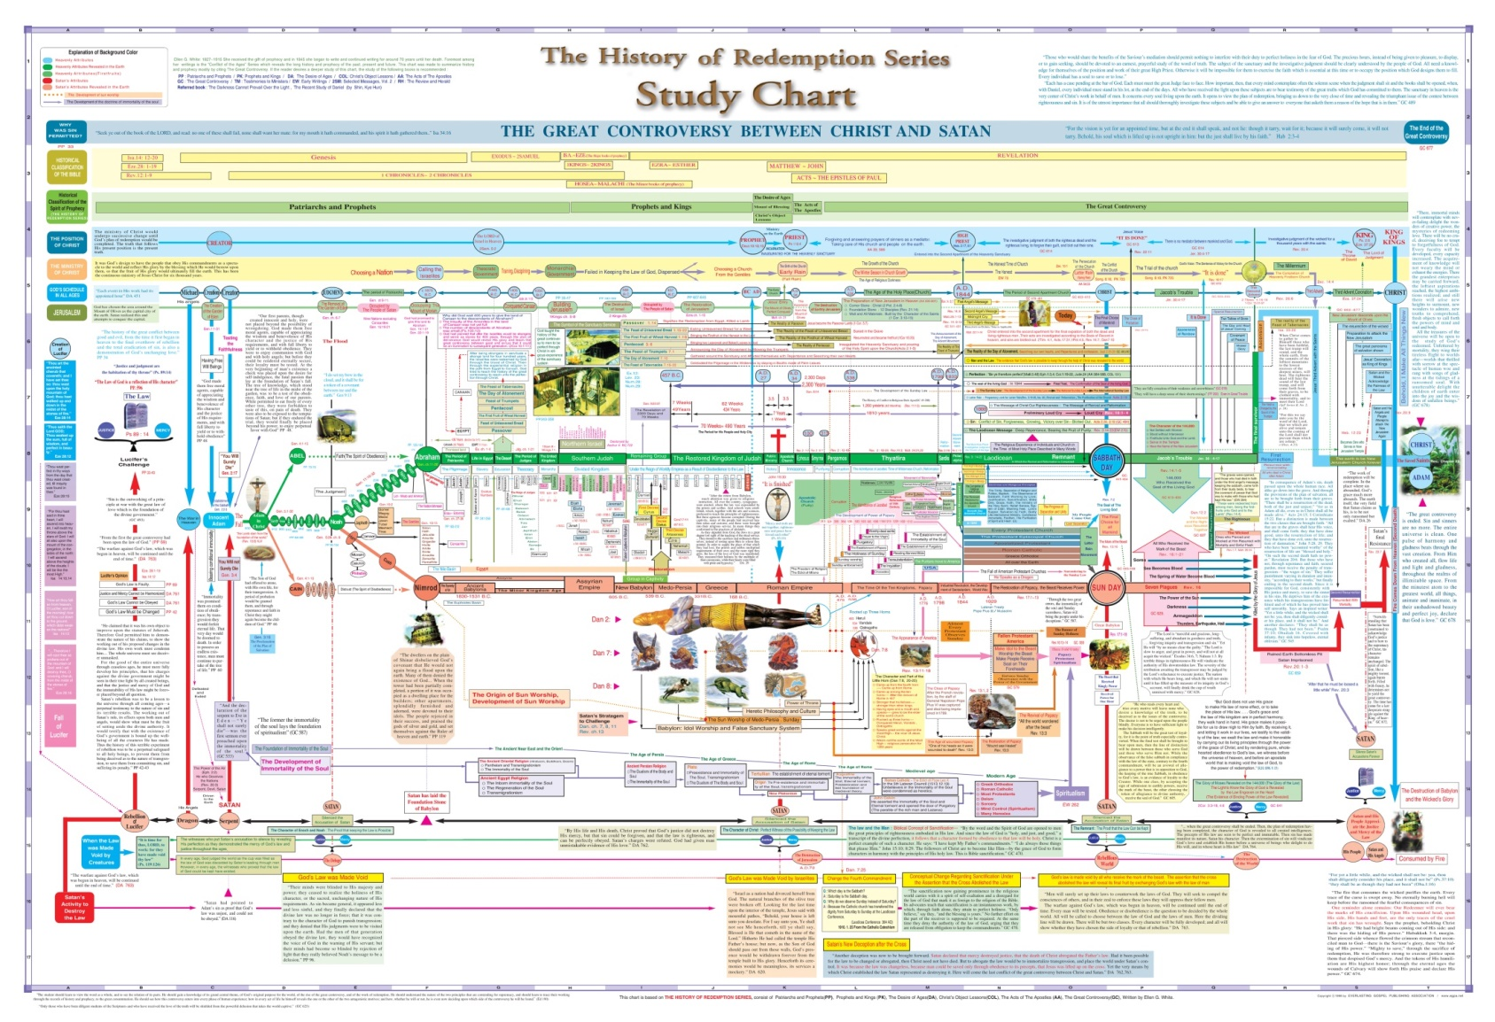
Is What the Bible TEACHES This Complicated?…

Slide 4

The Redemptive Puzzle
What Does It All Mean?

Slide 5

Where to Begin…
Understanding the
“BIG PICTURE”

Slide 6
“Our objective is to show that the relationship between the Old and New Testaments is one of PROMISE and FULFILLMENT in an absolute sense. There is not the slightest indication that any of the Old Testament promises were taken up in the New Testament and continued unfulfilled beyond the end of the Jewish age, or that the New Testament contains a new set of promises to be fulfilled beyond the Christian age”–
(Old Testament Israel and New Testament Salvation, p 7-8)

Slide 7

The Bible is …

Slide 8



Two Men and a Nation…
ISRAEL
ADAM
CHRIST

Slide 9
From the BEGINNING…
“Therefore, just as through one man [Adam] the sin entered the world, and the death through the sin, and thus the death spread to all men, because all sinned”— (Rom. 5:12)
ADAM

Slide 10
From the ENDS OF THE AGES…
“Therefore, as through one man’s [Adam] offense judgment came to all men, resulting in condemnation, even so through one Man’s [Christ] righteous act the free gift came to all men, resulting in justification of life” (Rom. 5:18)
CHRIST

Slide 11

What is the Connection?

Slide 12
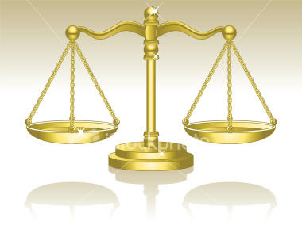
The REDEMPTIVE BALANCE…
ADAM
CHRIST
What was lost “in Adam” is RESTORED “in Christ’

Slide 13
ADAM
CHRIST
“Heavens and Earth”
Natural Man
Son of God
Prophet, Priest, King
Human Possibility
Condemnation
DEATH
THE LAW
THE SIN
THE DEATH
“ New Heavens and Earth”
Spiritual Man
Son of God
Prophet, Priest, King
God’s Possibility
Righteousness
LIFE
THE JUSTIFICATION
THE SANCTIFICATION
THE GLORIFICATION

Slide 14
Redemptive Restoration
Soteriology
Eschatology
“the study of the message and meaning of “salvation”
The importance of relationship with God
Justification
Sanctification
Glorification
the study of the message and meaning of “last things” [END RESULT]
How ‘redemptive history’ is a “fulfilled revelation”
Forgiveness now accomplished
Holiness ‘set apart’ for God’s service
Resurrection from ‘THE death’

Slide 15

Redemptive History
PROMISE
POSSESSION
PROCESS
ADAM
CHRIST
THE LAW
OLD COVENANT
NEW COVENANT
JUSTIFICATION
REMNANT
ISRAEL
THE SIN
SANCTIFICATION
THE DEATH
GLORIFICATION
Natural2Spiritual

Slide 16
Thank you for your attention ☺

