Slide 1
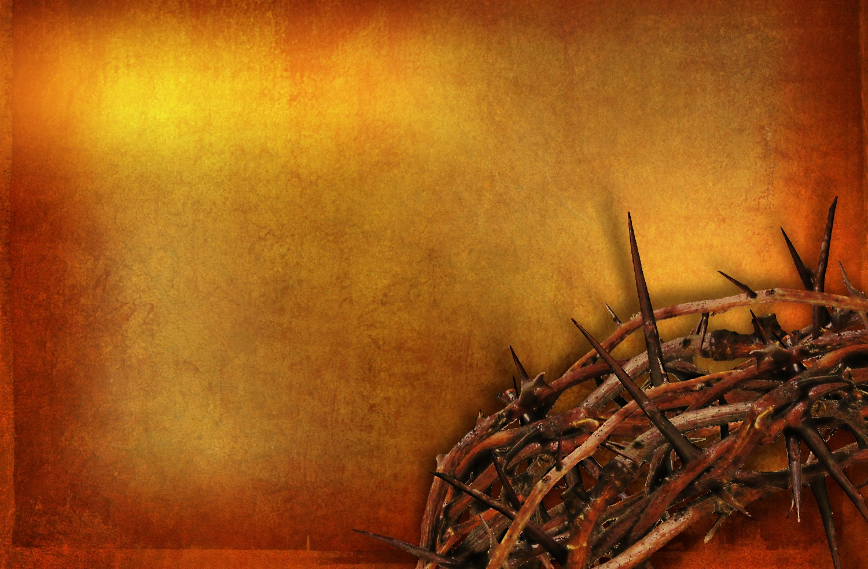
“WHY A CROWN OF THORNS?”

Slide 2
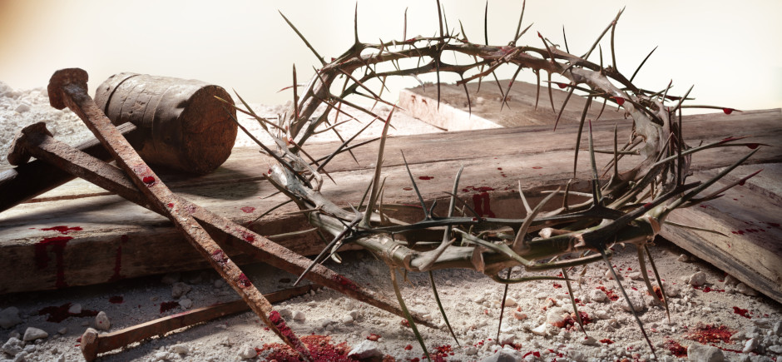
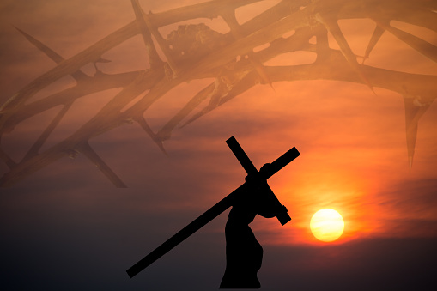
WHAT DO THE THORNS REPRESENT?

Slide 3
“WHY A CROWN OF THORNS?”
NOW WE KNOW WHY!

Slide 4
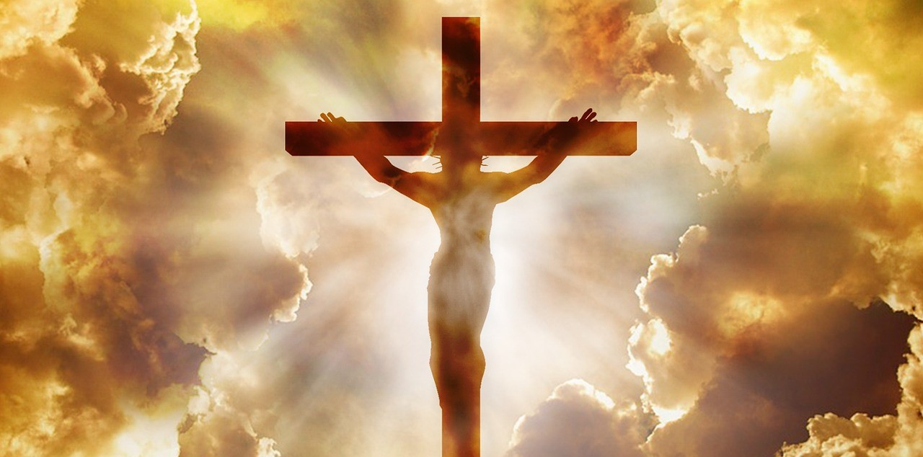
HE BORE THE THORN PIERCING PAIN OF OUR SINS
SO WE WOULDN’T HAVE TO

