Slide 1
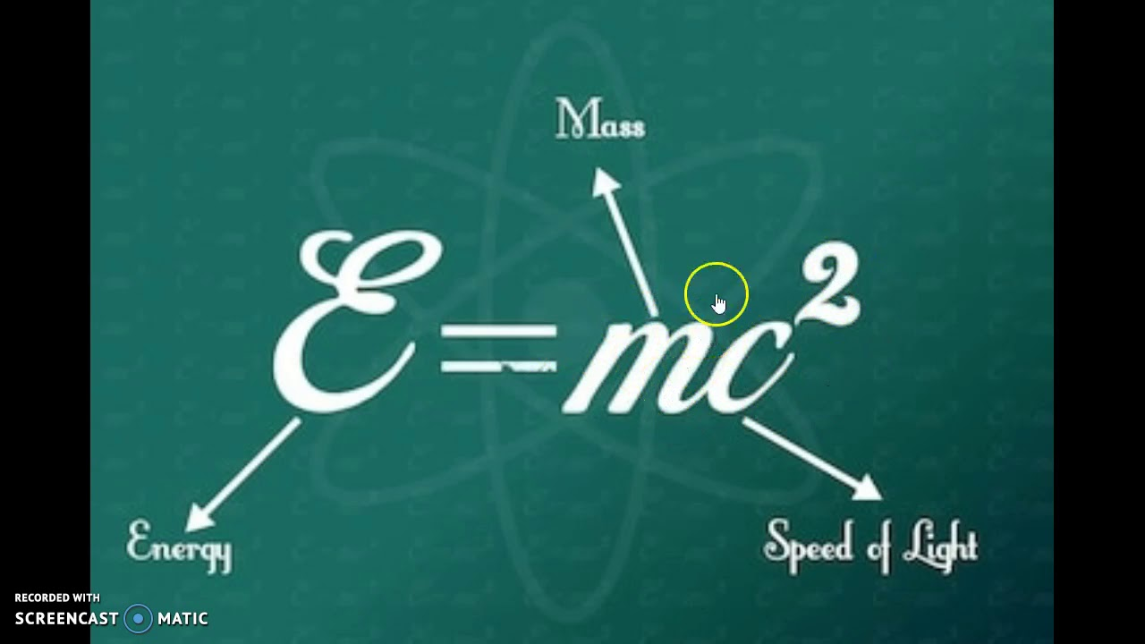
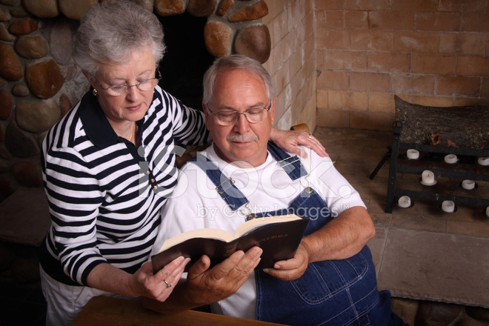
“SHARING THE GOSPEL NEED NOT BE COMPLICATED!”
IT’S JUST NOT THAT COMPLICATED
IT’S THIS SIMPLE

Slide 2
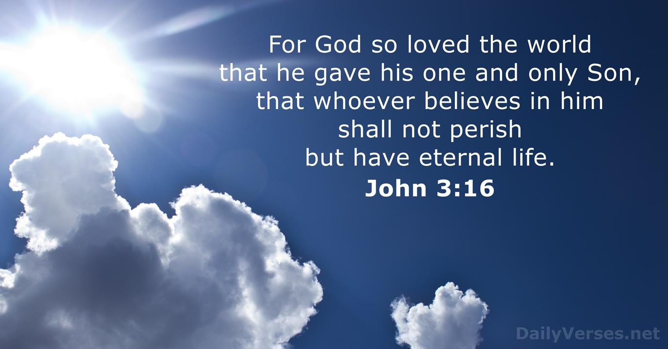

Slide 3


Slide 4
How do we begin our sharing of God’s Word with others?
First we should ask permission to share. Do not take for granted that all want to hear or are even ready and open to hear.
Start by asking the question; Have you ever heard John 3:16?
Then say this; It is a very important verse in the Bible. It contains “GOD’S MAIN MESSAGE TO MANKIND AND WHAT HE DESIRES FOR US.
May I share with you what I’ve discovered in this verse? (or what God wants for us)

Slide 5
USE THESE FIVE (5) KEY QUESTIONS TO GUIDE THE CONVERSATION
1 What does God want us to experience?
Talk about LIFE IN CHRIST

Slide 6
OUR FIVE KEY QUESTIONS; #2
What keeps us from experiencing this?
(Talk about the WORLD (SIN)

Slide 7
OUR KEY QUESTIONS #3
How does God feel about this?
(Talk about God’s nature)

Slide 8
OUR FIVE KEY QUESTIONS #4
How did God solve our problem?
(Talk about Jesus as the SON of God)

Slide 9
OUR FIVE KEY QUESTIONS #5
How do we begin to experience what God desires?
(Talk about belief in the Son)

Slide 10

For GOD so loved the WORLD that He gave His one and only SON that whoever BELIEVES in Him will not perish but have eternal LIFE.

Slide 11
What Does God Want You To Experience?
Talk about life – Something like this:
Real life is what God desires for you. He wants you to experience “real life” that addresses “real needs.”
Life to the full both now and forever! (eternally)
God wants you to know His acceptance of you. Right NOW, and experience His LOVE, FORGIVENESS, and PEACE.
It means to experience HOPE and His HELP now and throughout your life.
And to discover a life with real PURPOSE and DIRECTION.

Slide 12
What Does God Want Us To Experience?
God wants us to be EMPOWERED to do what is right in His sight.
Plus the hope and ASSURANCE of living with God FOREVER.
Give an example from your life how God has helped you and made a difference in your life. (TELL YOUR STORY)
If they are going through difficult times, point out that GOD CARES and wants to HELP AND LEAD them through too.

Slide 13
What Keeps You From Experiencing It?
Talk about the WORLD (our sin)
This is a broken world because of our sin
We all fall short of God’s perfection. We tend to ignore Him and do things that are not pleasing to the Holy and Perfect God.
Our sin creates a division and SEPARATION from God. This breaks our relationship with God now and will result in a permanent separation from His presence.

Slide 14
How Does God Feel About This?
Talk about God and His great love for all including the ones you are sharing the Gospel with
God LOVES you and wants you to know and experience His love
Because God is Holy, perfect and Just, He must punish sin
Because God loves you, God doesn’t want you to perish. He doesn’t want you to be separated from Him forever because of your sin
And the good news? God wants to help you break the problem of sin that separates you from Him
Therefore, God did something in His love for you to SOLVE YOUR PROBLEM!

Slide 15
How Did God Solve Your Sin Problem?
Remember our key verse – John 3:16; “For God so loved that He GAVE His Son”
Talk about the SON
God solved your sin problem in JESUS. HE IS THE SON!
Jesus is both God and man. He lived a sinless, perfect life and didn’t deserve to be punished
However, Jesus took your due punishment on the cross!

Slide 16

JESUS TOOK YOUR SIN TO THE CROSS AND PAID YOUR PUNISHMENT WITH HIS LIFE
JESUS NOW SETS AT THE RIGHT HAND OF THE FATHER AS YOUR ADVOCATE

Slide 17
How Do You Begin This “Real” Life?
It means to believe that JESUS is God’s Son
It means to trust in WHAT Jesus did for you on the cross. He died to take the full punishment for all your sins so you might be forgiven.
Jesus is alive at the righthand of God and desires to have a personal relationship with you. You can begin to experience life as He desires for you by receiving Him into your life.

Slide 18
How Do I Receive Jesus As Lord Of My Life?
HEAR THE WORD – ROMANS 10:17
BELIEVE IN JESUS AS THE SON OF GOD WHO CAME TO TAKE AWAY SIN –HEBREWS 11:6
REPENT – ACTS 17:30
CONFESS- ROMANS 10:9-10
BAPTISM – ACTS 2:38
REMAIN FAITHFUL – REV. 2:10

Slide 19


WHAT WILL YOU DO WITH JESUS MY FRIEND?
WILL WE PROCLAIM THE GOSPEL OF JESUS TO OTHERS?
OR WILL WE LOCK UP OUR FAITH?

