Slide 1
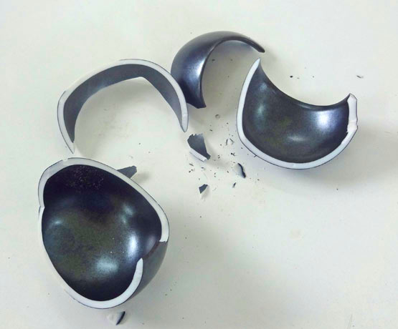
WHO’S GOT THE PIECES?

Slide 2
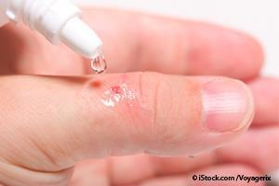
Ouch!

Slide 3
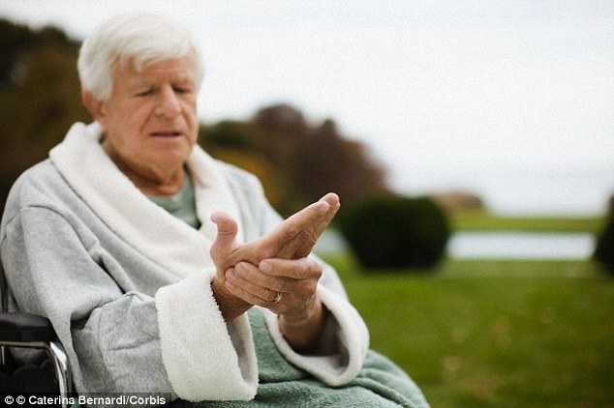
60 Years Of Knuckle Cracking

Slide 4
Oh No!

Slide 5
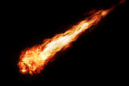
A Penny Is Not A Meteor!

Slide 6
LUKE CHAPTER { 7 }
A story from Luke that all of us can relate to and gain confidence through. A story that gives hope when there doesn’t seem to be any. A story that defines Paul’s statement, “When I am weak then I am strong.”

Slide 7
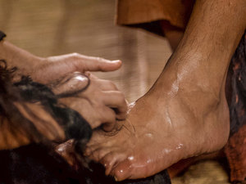
Heartbroken, she falls to the floor weeping and begins to wash the feet of Jesus with her tears

Slide 9
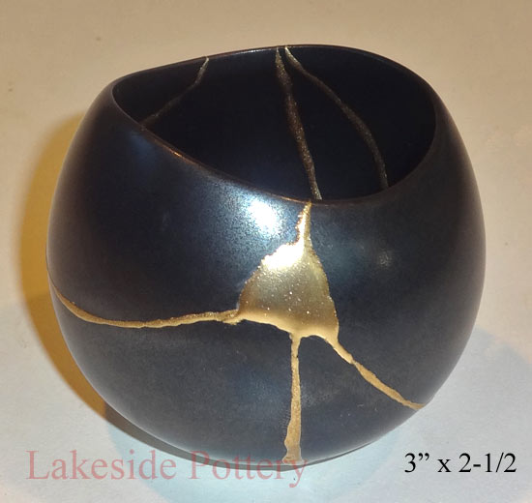
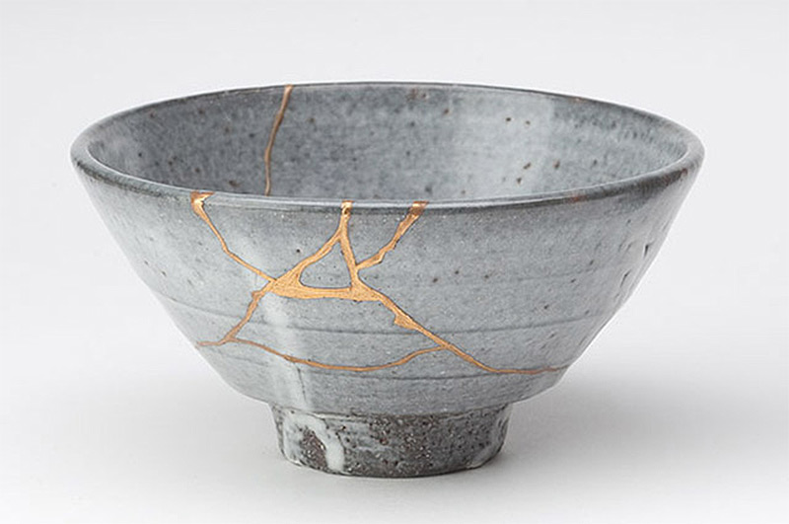
Just Like The Japanese Art Of “Kinsugi”, Jesus Makes From The Pieces A Vessel Of Value!

Slide 10
God takes the pieces of our lives and makes something beautiful

